Slide 1
SE 101 CSOON Prototype Demo
Jenny Chen
Amir Roshankar
Daniel Song
Talia Wang

Slide 2



Problem:
Cooking/cleaning/painting
Can’t use your phone without making a mess

Slide 3
Initial Solution:
Rotating laptop stand controlled by ultrasonic sensors
Hands hover over left/right sensor to turn the stand counterclockwise/clockwise respectively
Hand tracking with a laptop camera and OpenCV to scroll through PDFs with hand motions (not yet developed)
Notes:
Dan

Slide 4
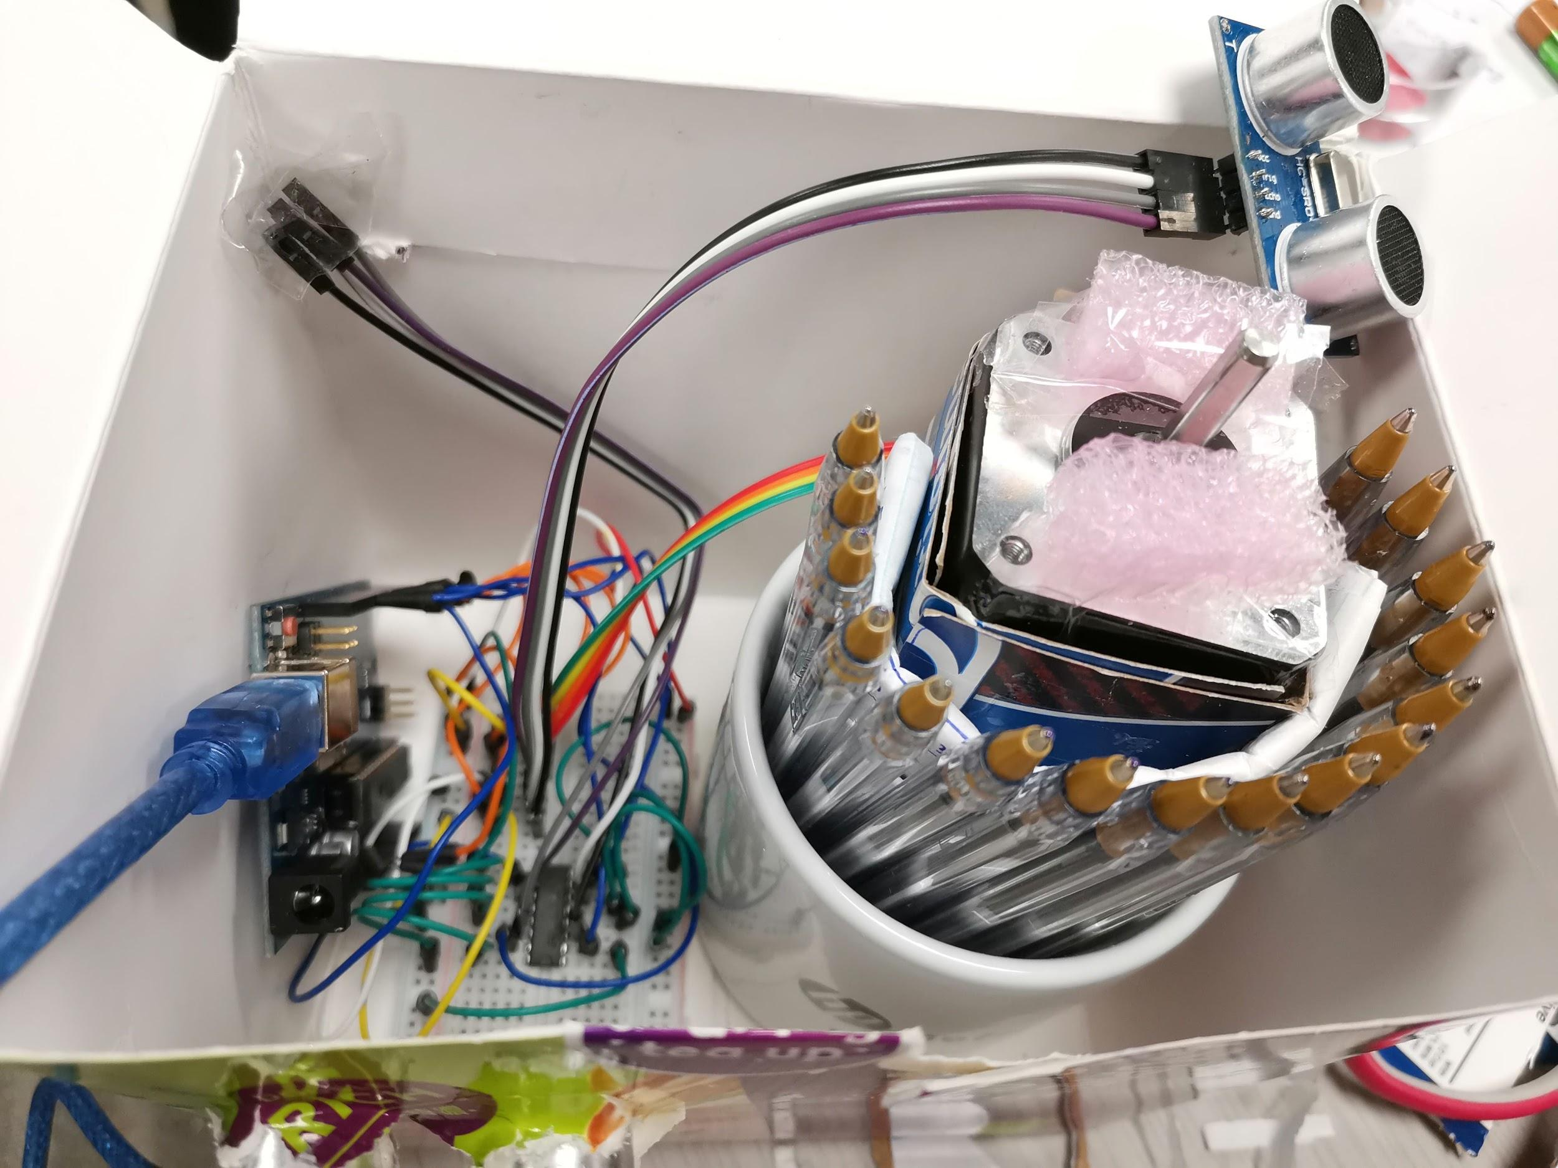
Our Prototype:
Rotating Stand
Hardware: 2 ultrasonic sensors, stepper motor, Arduino
Sensors detect when a hand is nearby
Arduino sends command to the motor to move to the next state as needed
Low-cost materials to maximize affordability
Notes:
Talia

Slide 5
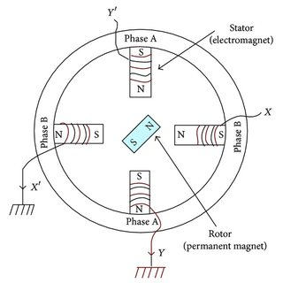
Our Prototype:
Rotating Stand
Simplification:
Motor has 4 states
200 steps in total
Direction of rotation is controlled by 2 ultrasonic sensors
Notes:
Jenny

Slide 6

Demo Video
Notes:
Jenny

Slide 7
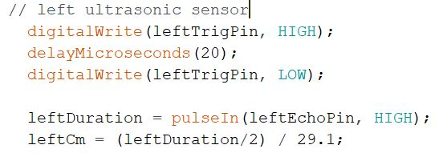
Stand Code
Read data from sensors
Notes:
Talia

Slide 8
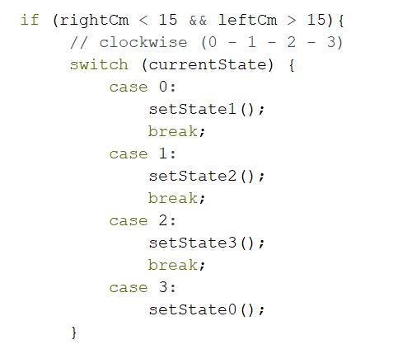
Stand Code
2) Connect data from sensors to control the motor
Notes:
Dan

Slide 9
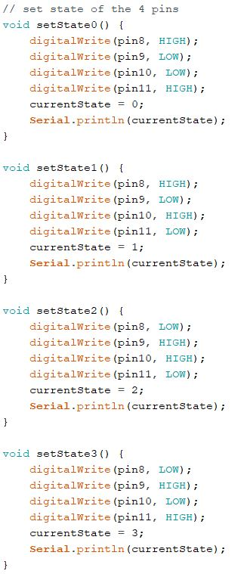
Stand Code
3) Set the motor (to turn) to the next state
Notes:
Amir

Slide 10
Challenges Faced
Thus Far
Wiring and Setup
Power supply
Using ultrasonic sensors to control motor
Supporting weight
Notes:
Amir

Slide 11
How we Addressed
Challenges
Checked wiring with multiple similar schematics
Not using batteries to power the motor, but a DC Power Supply
Printing values from ultrasonic sensors and motor states
Switching idea from laptop to phone to reduce weight
Notes:
Dan

Slide 12
Future Tasks and Challenges
Making our wiring/attachments permanent with soldering/gluing
Hand recognition with a camera, and putting this on a mobile app
Stabilizing our stand
Obtaining a higher voltage power source to power motor
Notes:
Talia

Slide 13
AC to DC converter/Step down transformer that connects to the wall sockets
Do more research into OpenCV
Develop software to recognize hand gestures and associate them with PDF commands
Notes:
Jenny

Slide 14
Plans to Overcome Challenges
If we use a DC brush motor we may be able to build and keep momentum
We will sacrifice control, however, so it will be a last resort
Connecting the rotor to the platform with a belt
Allows us to fortify stand and spin more weight
Notes:
Amir

Slide 15

Thanks for listening

